Slide 1
Instrumental Analysis

Slide 2
Instrumentation
Paper Chromatography
GC – Gas Chromatography
HPLC- High Performance Liquid Chromatography
IR – Infrared Spectroscopy
UV-Vis Spectroscopy
MS – Mass Spectrometry
NMR – Nuclear Magnetic Resonance

Slide 3
Chromatography
Chromatography is a method of separating mixtures by their attraction to a stationary phase.
The Stationary phase is chosen due to its polarity.
The mixture to be separated is dissolved in a substance or carried by a substance that helps it travel past the stationary phase.
The solvent is called the mobile phase.
As the solvent travels, the parts of the mixture that are more attracted to the stationary phase move slower than the parts that are less attracted.

Slide 4
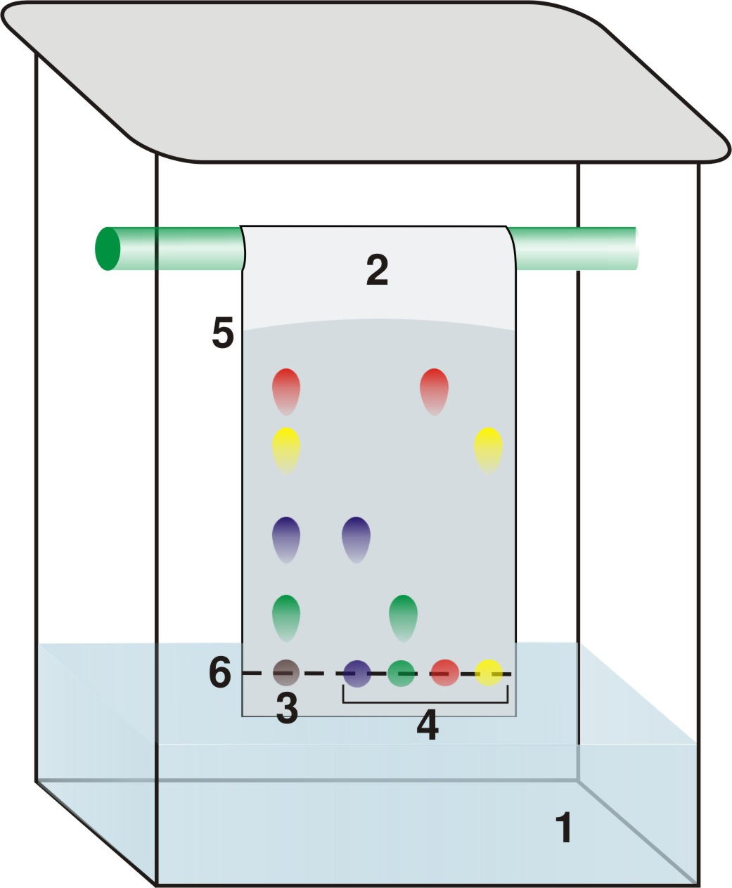
Paper Chromatography
Can be done with drugs, inks, dyes, etc.
Mobile phase is usually an organic solvent like methanol, hexane, or carbon tetrachloride.
Stationary phase can be paper or a chromatography “plate.”

Slide 5
Gas Chromatography
Sample is injected into a port and mixed with a carrier gas. (could be nitrogen or helium)
Gas is heated by an oven and runs through a very long coiled silica column that contains the stationary phase.
Gas comes out the other end and the parts of the mixture go through a detector (flame or electric) which determines when they have arrived.
The retention time (how long inside the column) is used to identify the parts.
Now just used to separate the components before entering a Mass Spec or IR.

Slide 6
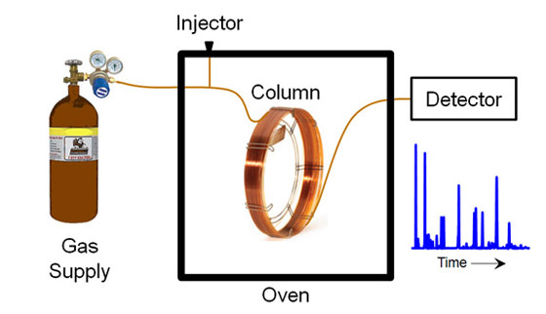

Slide 7
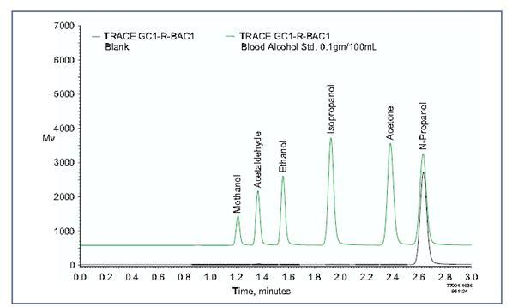
Chromatograph
Not only identifies, but by integrating under the curve you can determine quantities present in the mixture as well.
Used to do it by hand, computers are wonderful!

Slide 8
HPLC
A column is created with a packed stationary phase made up of tiny granules.
The mixture is dissolved in a solvent like water methanol, acetonitrile.
Instead of letting gravity pull the liquid through, it is put under high pressure anywhere from 50 – 1000 atmospheres.
Also used as a separator before passing the mixture through another detector.

Slide 9
IR Spectroscopy
When infrared radiation is absorbed by a molecule, it causes the bonds to bend and stretch.
This energy is absorbed by the molecule and transferred to kinetic energy, so an absorption spectrum can be created.
Different bonds absorb at different wavelengths and in different amounts, so it is possible to identify each substance by its unique spectrum.

Slide 10
Movements
Asymmetric stretching
Symmetric Stretching
Scissoring
Rocking
Twisting
Wagging

Slide 11
Absorption Regions
Typical detectors measure the absorbance in the 1000-4000 cm⁻¹ range (called wavenumbers)
v = 1/λ or the number of wavelengths per distance.
Wavelengths would be in the 2000 – 20000nm range.
Functional groups and double bonds have distinct locations and shapes on the spectrograph that makes them easier to pick out.
Interaction with other parts of the molecule further complicates the exactness.

Slide 12
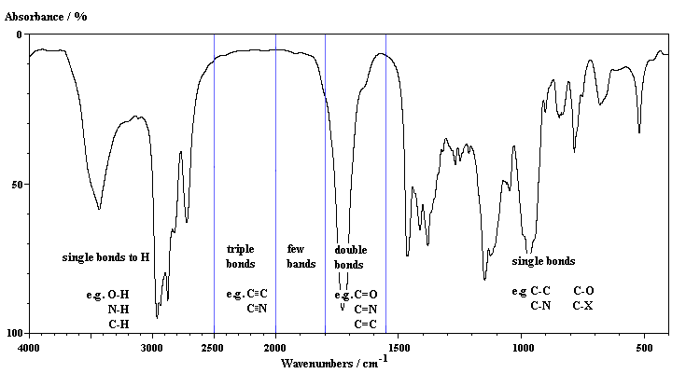
Functional group absorption
OH bonds tend to have large and broad absorbencies.
Double bonds tend to be sharp spikes
Below 1500 is called the fingerprint region and is tough to identify particulars alone.

Slide 13
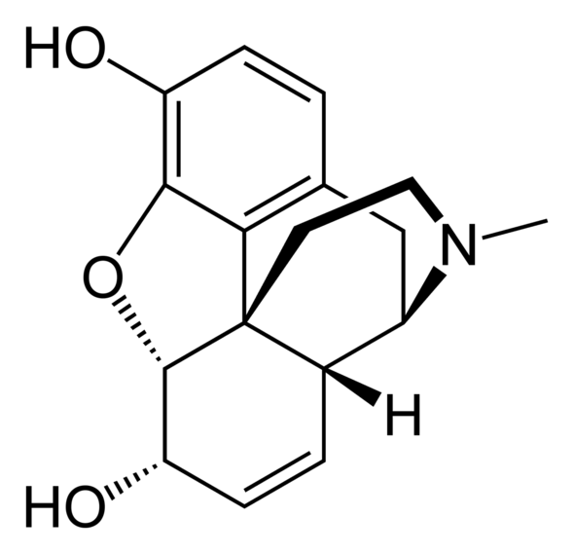
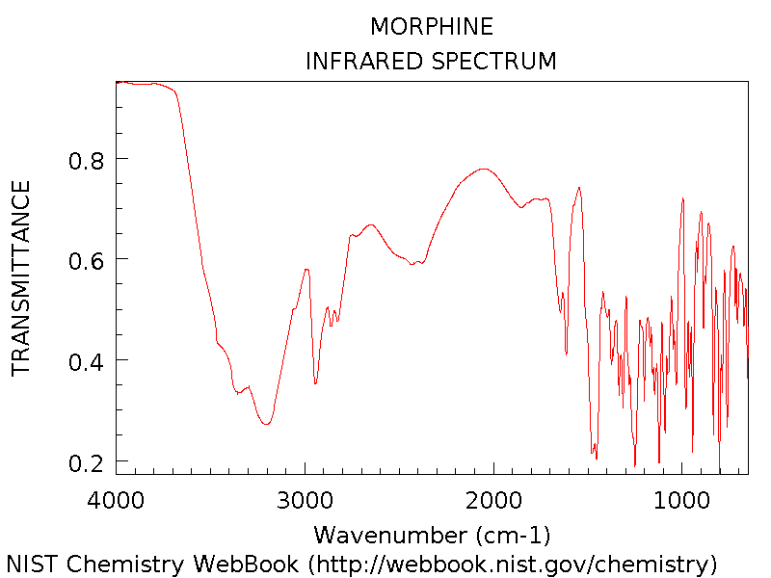
IR of Morphine

Slide 14
UV-Vis Spectroscopy
Deals with absorption of visible and near UV light.
Causes electrons to transition to higher energy levels.
Energy is absorbed when those transitions occur.
Can be used for metals, biological macromolecules, and conjugated organic compounds.

Slide 15
Mass Spectroscopy
Works by breaking the molecules up into fragments of varying masses.
Fragments are ionized (carbocations) at the injection site.
Fragments pass through a quadrapole which changes in frequency causing ions to oscillate while passing through.
Different mass ions will be more or less effected.
At each resonance frequency a specific ion will pass through.

Slide 16
Mass Spectroscopy
The mass spectrometer changes the frequency so only one mass ion will pass through at a time.
As each ion passes through it gets detected at the other end.
Each fragment can then be determined by its mass, and the largest fragments can be use to determine the molar mass of the compound.

Slide 17
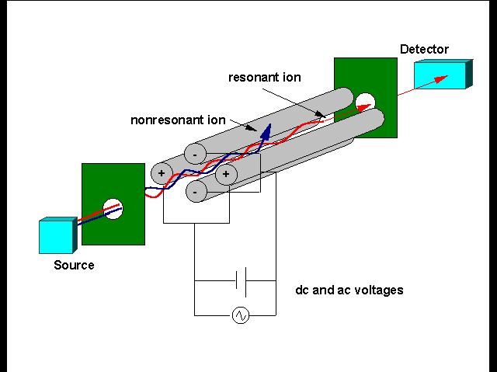
Quadrapole Mass Spec

Slide 18
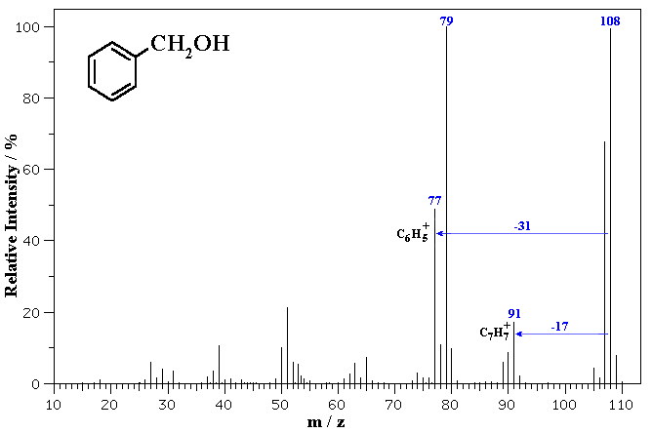
Mass Spectrograph

Slide 19
Nuclear Magnetic Resonance
NMR uses magnetic fields to cause nuclei of atoms to resonate.
Different nuclei will absorb and release photons at different energies which enables detection.
Electrons also create magnetic fields that shield the nucleus.
This shielding causes changes in the resonance energies of the nuclei which is related to electron density.
Can help determine the structure of complex molecules.
Usually focused on hydrogen nuclei.
Does not destroy the sample.

Slide 20
